Slide 1
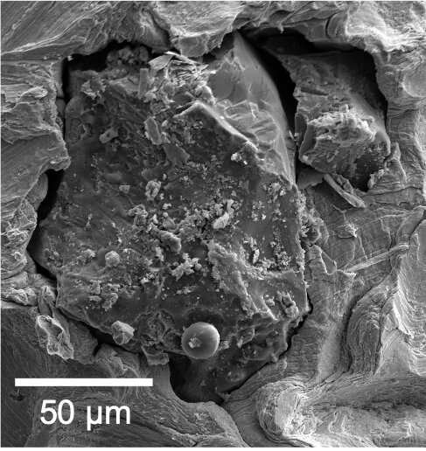
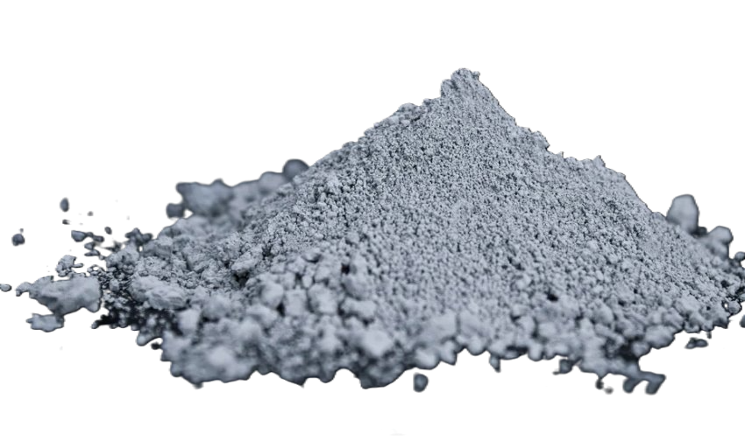
Lunar Dust Glovebox
Team 516 – M. Brahmbhatt, N. Britton, R. Dreibelbis, K. Kovacs, P. Mougey, L. Terrell
Advisors – Dr. Shayne McConomy and Dr. Brandon Krick
Background
The Objective
Lunar dust is the top layer of lunar regolith – the moon's surface. The average diameter of a lunar dust particle is 40% smaller than the average diameter of a human hair.
The objective of this project is to optimize air flow to evenly distribute lunar dust simulant throughout a lunar dust glovebox.
Key Goals
CFD Results
CFD Results
The image shows a lunar dust particle's jagged edges, circled in red, and irregular shape making it very sharp. These qualities make lunar dust:
Model airflow using computational fluid dynamics (CFD) and determine fan angles and positions for an even distribution.
CFD is software used to model fluid movement, such as airflow from CPU fans. The CFD simulation was run with various fan setups to find the configuration that provided the most even airflow. The gradient shows air velocity 60 seconds into the experiment. Dark blue indicates low velocity areas where the simulant may accumulate. The range from lighter blue to red represents the velocity needed to lift particles, suggesting the simulant will be evenly distributed.
Construct a tangible glovebox with adjustable fans to experiment in.
Run experiments in the glovebox using lunar dust simulant.
Toxic to inhale
Deteriorate space suits
Analyze the results and compare with the CFD to determine if the CFD is accurate and if the simulant is evenly distributed.
Tangible Glovebox CAD
Experiment Procedure
Enclosed funnel for simulant deposit
Dehydrate lunar dust simulant to reduce clumping
Place the UV lights, fans, and cameras in desired positions
Close and seal the glovebox by bolting down gasket top
Test the glovebox for leaks
Turn on the UV lights and fans
Deposit the simulant into the glovebox using the funnel
Plug the funnel to seal the funnel enclosure
Take photos at specified times and locations
Clean interior of glovebox and dispose of used simulant post-run
Compromises Lunar Modules
Lunar Dust Highland Simulant
The Problem
Use a simulant, real lunar dust is hard to find
Lunar Highlands Simulant
Mineralogically accurate to real lunar dust
Mimics real lunar dust
NASA uses a sealed glovebox to test how lunar dust affects objects when exposed to a lunar dust simulant. CPU fans circulate the dust, but it often gets stuck in the corners, causing uneven airflow.
UV Light & Fluorescent Spheres
Bolted gasket seal
The simulant's small size made its movement invisible to the naked eye. Fluorescent microspheres, mimicking the simulant, were added to the airflow. UV light made them glow for photography and analysis of distribution.
Adjustable fan mounts
Scan to see the final analysis on our website!

